Slide 1
Monitoring framework for training and placement activity.
Group : Project Guide:
Hiba Rajguru Prof. Rujata Chaudhari
Saurabh Kolambkar Prof. Anagha Aher
Omkar Shelar

Slide 2
Abstract
This System is developed for proper management of placements activities in our campus.
This project provides in-detail information of companies and student information at various user levels.
Student handbook database is taken as input for resume builder feature.
TPO officer controls major part of information flow in this system.

Slide 3
Introduction
This project aims at developing a online portal for training and placement department of the college.
The system is an online application that can be accessed throughout the organization with various access controls for different users.
This system can be used as an application for the TPO of the college to manage the student information with regards to placement.

Slide 4
Problem statement
Manual management of training and placement activities.
Difficult for the training and placement officer for maintaining records.
Verification of student documents is time consuming.
Notifications about upcoming drives, placement procedures or expert talks may or may not reach the students.

Slide 5
Project Scope
Automation of shortlisting student as per Company Drive.
Proper Management of Training and Placements Activities.
Notify students about upcoming events via SMS.
Notify TPO officer about student resume updation.
Easier student document verification.
Better overview of all campus drives.

Slide 6
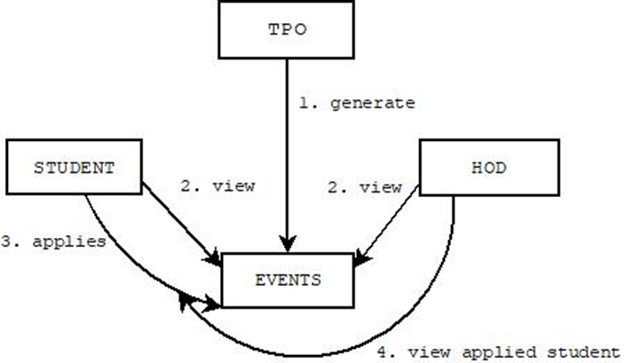
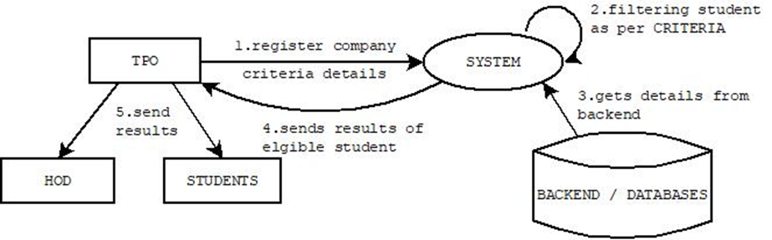
Design
Events generations → Home page
Company Registrations and filtering eligible students

Slide 7
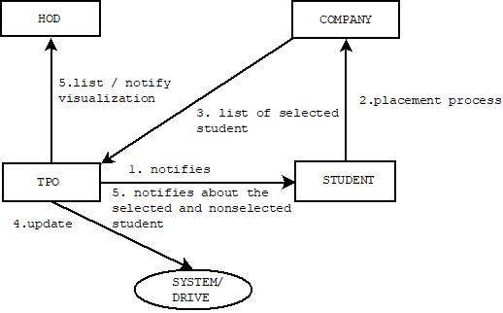
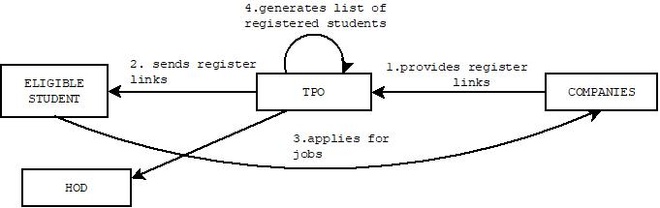
Design
Updating Drive by TPO
Application by Eligible students.

Slide 8
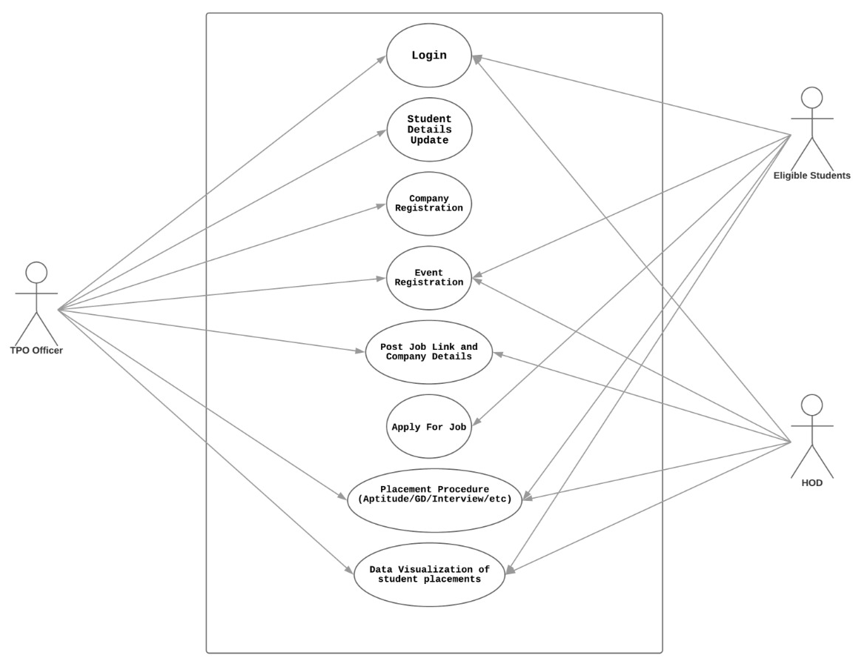
Use case diagram

Slide 9
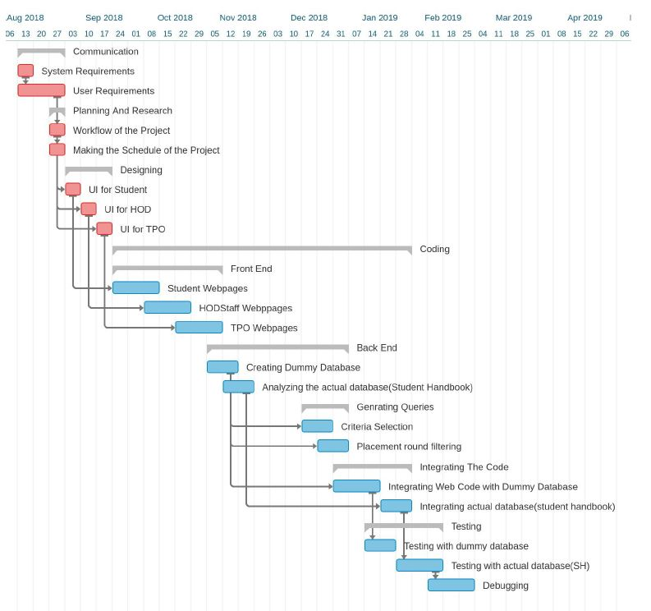
Project Plan

Slide 10
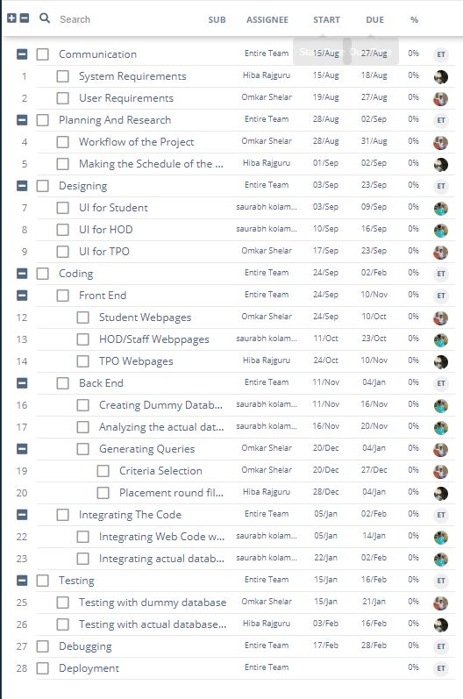
Resource Management

Slide 11
Security
Manage who has access.
Ensures protection of the most important data.
Develop stronger passwords.
The data in system should be
Regularly back up is necessary.

Slide 12
Summary
The phases that we have achieved till yet are as follows
Research
Analysis of Technology Stack
Layout Designing

